Slide 1


Reva Rubin’s Theory of Maternal Identity Understanding Maternal Role Attainment and Nursing Implications
Anna Drake MA RN ICCE RYT
NUR 304 Concepts of Professional Nursing
Prof. Amanda Thaller MSN ACNP AHN-BC RYT
October 11, 2025

Slide 2
Learning Objectives
Describe Rubin’s core concepts of maternal identity.
1
Identify the stages of maternal role attainment.
2
Explain the four major maternal tasks.
3
Apply Rubin’s theory to contemporary nursing practice.
4
Analyze the theory’s limitations and evolution into modern frameworks.
5

Slide 3
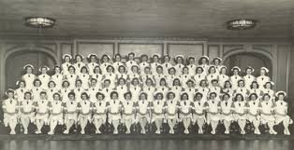
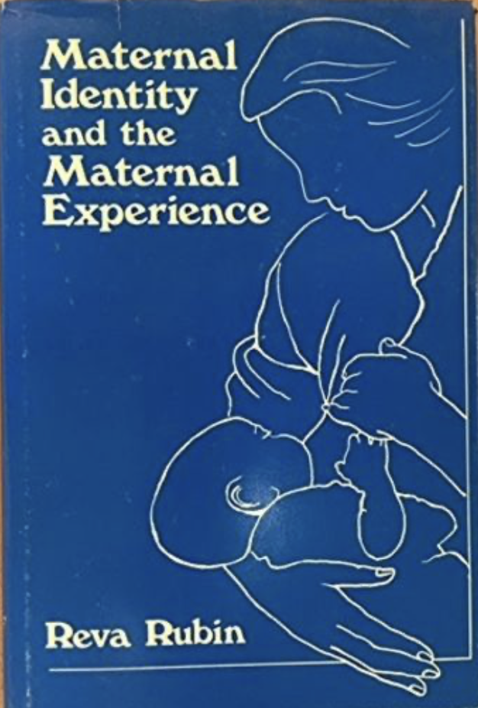
Introduction to Reva Rubin
Image credit: Elischolar (2025)
Reva Rubin (b. 1919 - d.1995) was one of the first nurse theorists to explore motherhood as a psychosocial journey, not just a biological event.
In her 1984 book Maternal Identity and the Maternal Experience, she argued that becoming a mother is a gradual developmental process, shaped by culture, support, and personal growth (Mercer, 1995).
Her ideas laid the foundation for modern maternal-child nursing theory.
Image credit: Biblio (2025)

Slide 4

Maternal Role Attainment
Rubin described motherhood as a role women learn and integrate over time. It is not instantly achieved at birth but unfolds through lived experience, self-reflection, and guidance.
This process is called maternal role attainment. The theory remains one of her key contributions to nursing practice (Rubin, 1984; Mercer, 2004).
Here is a link to a 1989 interview of Reva Rubin, discussing her theory.
This Photo by Unknown Author is licensed under CC BY

Slide 5

Four Maternal Tasks
Rubin identified four essential task women taken on during the pregnancy, birth and postpartum experience (perinatal period):
This Photo by Unknown Author is licensed under CC BY
Ensuring safe passage for themselves and their infants.
Gaining acceptance of the baby by family and others.
Developing emotional attachment, referred to as “binding in.”
Giving of self to meet the baby’s needs.
These tasks highlight both the physical safety and the relational-emotional dimensions of motherhood (Rubin, 1984; Rafii et al., 2020).

Slide 6

Stages of Maternal Identity
Rubin outlined four stages that mothers move through:
Anticipatory (pregnancy): preparing for the role.
Formal (early postpartum): following expected behaviors.
Informal: adapting and personalizing the role.
Personal: achieving confidence and identity as a mother.
These stages help nurses understand where a woman may be in her journey and tailor care appropriately (Frese & Nguyen, 2022).
This Photo by Unknown Author is licensed under CC BY

Slide 7
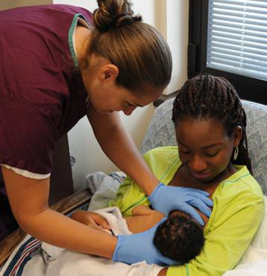
Influencing Factors
Maternal identity formation is not uniform. It is influenced by:
Personal factors (age, culture, mental health, prior pregnancies).
Social factors (partner support, family expectations, community norms).
Nursing care (education, emotional support, guidance).
These factors emphasize nursing’s critical role in providing both clinical care and psychosocial support (Sleutel 2003; Jack et al., 2005).
This Photo by Unknown Author is licensed under CC BY

Slide 8

Application to Nursing Practice
Rubin’s theory continues to shape maternal nursing today.
This Photo by Unknown Author is licensed under CC BY
Nurses apply it by:
Offering anticipatory guidance during pregnancy.
Supporting bonding and attachment after birth.
Encouraging mothers to develop confidence in their own style of parenting.
It is especially useful in perinatal, intrapartum, postpartum, and community health nursing (Sleutel, 2003).

Slide 9


Evolution in Modern Nursing
Rubin’s ideas inspired Mercer’s Becoming a Mother (BAM) theory, which broadened the scope to include long-term role development. More recent analysis emphasize inclusivity and cultural diversity (Frese & Nguyen, 2022; Hwang et al., 2022).
Today, maternal identity is seen as a dynamic, context-sensitive process, relevant across nursing specialties and family systems.
This Photo by Unknown Author is licensed under CC BY
This Photo by Unknown Author is licensed under CC BY

Slide 10

Critiques & Limitations
While groundbreaking, Rubin’s theory has limitations:
It assumes a somewhat uniform maternal trajectory.
Early versions were often baby-centered, not mother-centered.
Less applicable across diverse cultural and family structures (e.g. LGBTQ+, single parents).
Feminist critiques suggest it can reinforce norms rather than highlight women’s diverse lived experiences (Parratt & Fahy, 2011).
This Photo by Unknown Author is licensed under CC BY

Slide 11
Summary & Closing
Reva Rubin changed how nursing understands motherhood, seeing it as a gradual, developmental identity rather than an automatic event.
Her four maternal tasks and stages continue to guide nursing care, while later theories have built on her framework to reflect diversity and inclusivity.
Rubin’s legacy reminds us that nursing care is not just physical, but deeply psychosocial and relational (Fawcett, 2023; Mercer, 2004).

Slide 12
References 1/2
Fawcett, J. (2023, December 5). Rubin’s theory of clinical nursing and theory of maternal identity. Nursology. https://nursology.net/nurse-theories/theory-of-maternal-identity/
Frese, B.J., & Nguyen, M.H. (2022). The evolution of maternal role attainment: A theory analysis. Advances in Nursing Science, 45(4), E161. https://doi.org/10.1097/ANS.0000000000000462
Hwang, W.Y., Choi, S.Y., & An, H.J. (2022). Concept analysis of transition to motherhood: A methodological study. Korean Journal of Women Health Nursing, 28(1), 8-17. http://doi.org/10.4069/kjwhn.2022.01.04
Jack, S. M., DiCenso, A., & Lohfeld, L. (2005). A theory of maternal engagement with public health nurses and family visitors. Journal of Advanced Nursing, 49(2), 182-190.
https://doi.org/10.1111/j.1365-2648.2004.03278.x

Slide 13
References 2/2
Mercer, R. T. (1995). A tribute to Reva Rubin. MCN: The American Journal of Maternal/Child Nursing, 20(4), 184. https://doi.org/10.1097/00005721-199507000-00002
Mercer, R. T. (2004). Becoming a mother versus maternal role attainment. Journal of Nursing Scholarship, 36(3), 226–232. https://doi.org/10.1111/j.1547-5069.2004.04042.x
Parratt, J. A., & Fahy, K. (2011). A feminist critique of foundational nursing research and theory on transition to motherhood. Midwifery, 27(4), 445–451. https://doi.org/10.1016/j.midw.2010.02.012
Rafii, F., Alinejad-Naeini, M., & Peyrovi, H. (2020). Maternal role attainment in mothers with term neonate: A hybrid concept analysis. Iranian Journal of Nursing and Midwifery Research, 25(4), 304-313. https://doi.org/10.4103/ijnmr.IJNMR_201_19
Sleutel, M. R. (2003). Intrapartum nursing: Integrating Rubin’s framework with social support theory. Journal of Obstetric, Gynecologic & Neonatal Nursing, 32(1), 76–82. https://doi.org/10.1177/0884217502239803

